Slide 1

TypeShift
A WEB-BASED PLATFORM PRACTICE AND IMPROVE TYPING.
TEAM MEMBERS
Aditya Mishra
2400520100008
Anushaka Prasad
2400520100020
Darshika Singh
2400520100029
Devansh Singh
2400520100032
Harshit Yadav
2400520100038

Slide 2

Table of Contents
1
2
3
Project Overview
Comparison with Existing Systems
Technologies and Tools Used
4
5
Project Development Timeline
Current Progress and Work Status

Slide 3




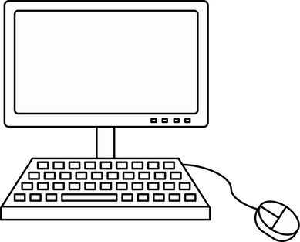



Project Overview
TypeShift is a web-based tool built to help users track and improve their typing performance. The platform provides a focused environment for testing speed and accuracy, with a backend designed to store and display progress over time.
User Authentication
Navigation Bar:
A dedicated login gateway featuring username and password inputs, along with a registration link for new users.
A consistent header providing quick access to the typing test, leaderboard, and user profile.
Project Overview
Typing Environment:
Leaderboard
A centralized "testbox" area designed for the core typing experience.
A data-driven table layout to display top user rankings and performance scores.
Live Settings
Performance Dashboard
Functional dropdown menus that allow users to switch between different typing "modes" and "languages" without leaving the main screen.
A profile page that tracks individual user "Stats," including Highest WPM (Words Per Minute), Average Accuracy, and total Tests Completed.

Slide 4
Project Comparison
We will aim to achieve these features after implementing a basic prototype.
Feature | TypeRacer | Typeshift | MonkeyType
Custom word lists | ❌ | ✅ | Limited
Difficulty levels | ❌ | ✅ Easy/Common/Hard | Limited
Personal progress graph | ❌ | ✅ | ✅
Leaderboard | ✅ | ✅ | ❌
Reaction on mistype | ❌ | ✅ (GIF feature) | ❌
Login & personal records | ✅ | ✅ | ✅

Slide 5
Tools Used
1. Frontend
JavaScript – Core programming language for the client side.
React - Building dynamic, component-based user interfaces.
HTML5 & CSS3 – Structure and styling of the website.
2. Backend
Node.js – Handles server-side logic.
Express.js – Used to build the API and manage server routes.
3. Database
MongoDB – Stores user accounts, statistics, and leaderboard data.
4. Other Tools & Services
Git - Version control system.
GitHub – Source code management and collaboration.
Vite - fast development, instant hot module replacement (HMR), and optimized production builds.

Slide 6
Timeline of the Project
_ . I
Week 1–2
Planning & Research
_ . I
Week 5-6
Core Functionality Implementation
_ . I
Week 3-4
UI Design & Development
_ . I
Week 7-8
Testing & Finalization

Slide 7



Status of Work Done
COMPLETED
ONGOING
PLANNED
UI and layout planning finished.
Core features decided.
Interactive Figma prototype built.
User navigation flow mapped.
Building frontend components in React.
Develop backend and database schema.
Connect MongoDB for user stats.
Code real-time typing logic.
Final hosting and site deployment.

Slide 8
The End
THANK YOU FOR LISTENING

